Slide 1

29-06-2023
ENIAC

Slide 2

About the Company
Eniac is an online marketplace specializing in Apple-compatible accessories.
It was founded ten years ago in Spain and has since grown and expanded to other neighboring countries.

Slide 3
Scope
The main purpose of the presentation is to recommend whether or not to sign the deal with Magist.
Our Goals
Eniac is exploring an expansion to the Brazilian market.
Magist is a Brazilian Software as a Service company that offers a centralized order management system to connect small and medium-sized stores with the biggest Brazilian marketplaces.
Magist is already a big player and allows small companies to benefit from its economies of scale:
Eniac is considering signing a 3-year contract with Magist as an intermediate step, while it tests the market, creates brand awareness, and explores the option of setting up its own supply chain management.

Slide 4
TWO CONCERNS
There are two main concerns:
Eniac’s catalogue is 100% tech products and heavily based on Apple-compatible accessories. It is not clear that Magist is a good partner for these high-end tech products.
Among Eniac’s efforts to have happy customers, fast deliveries are key. Are deliveries fast enough?

Slide 5
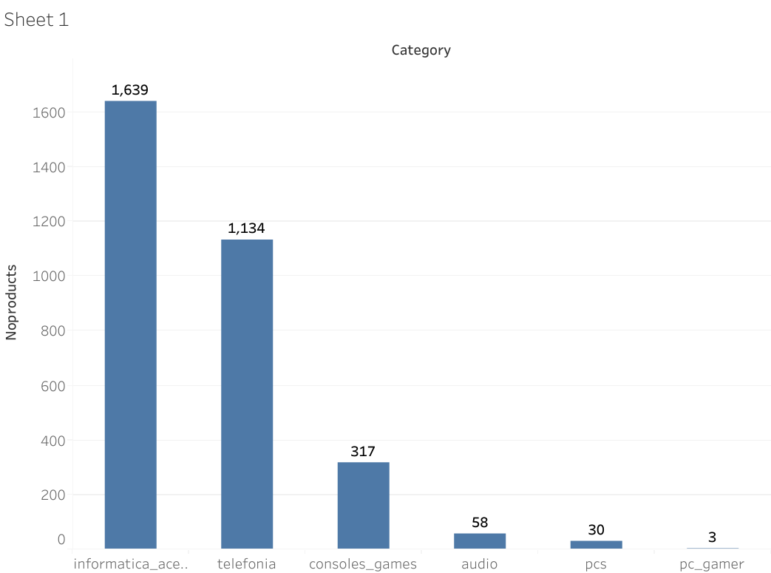
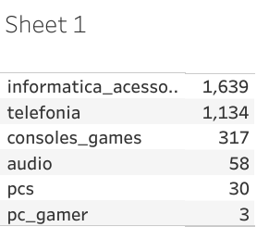
What categories of tech products does Magist have?

Slide 6
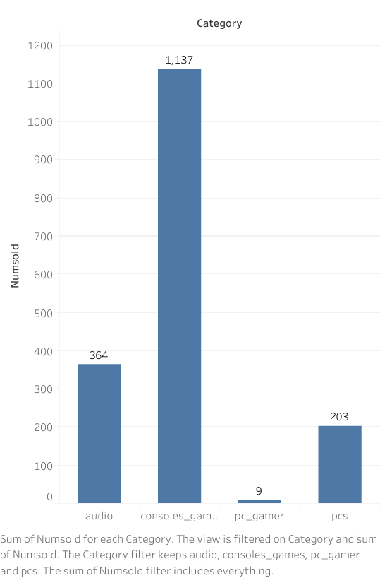
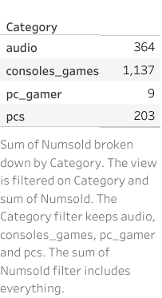
How many products of these tech categories have been sold ?

Slide 7
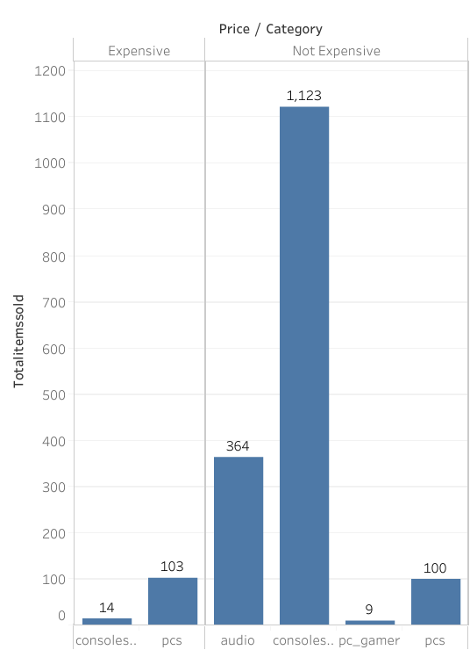
Are expensive tech products popular?

Slide 8
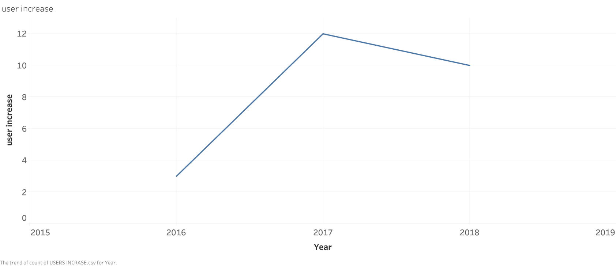
Users level per year

Slide 9
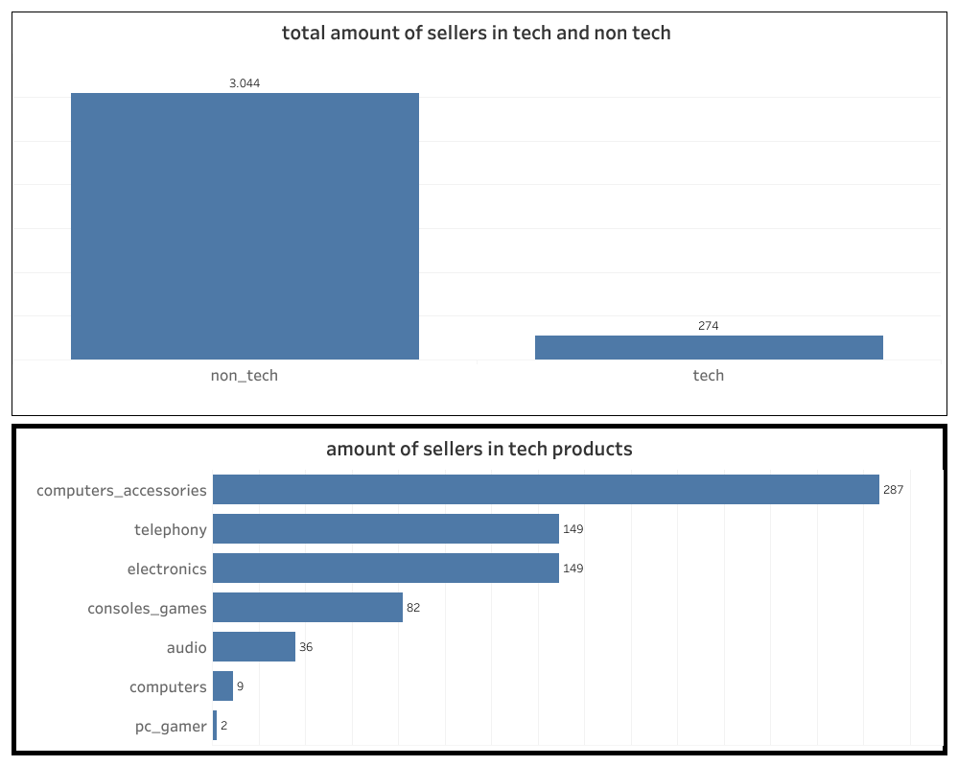

Slide 10
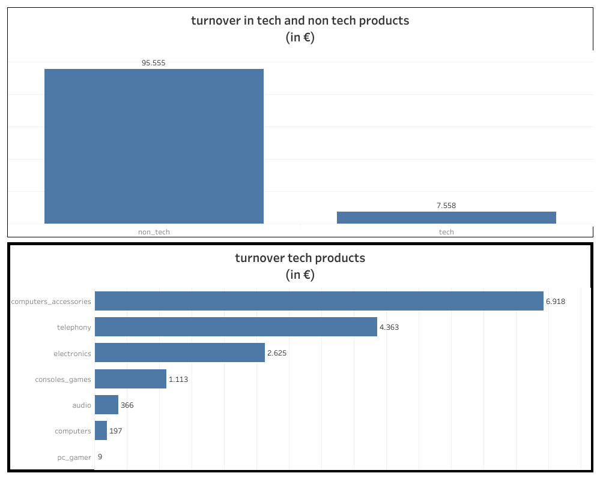

Slide 11
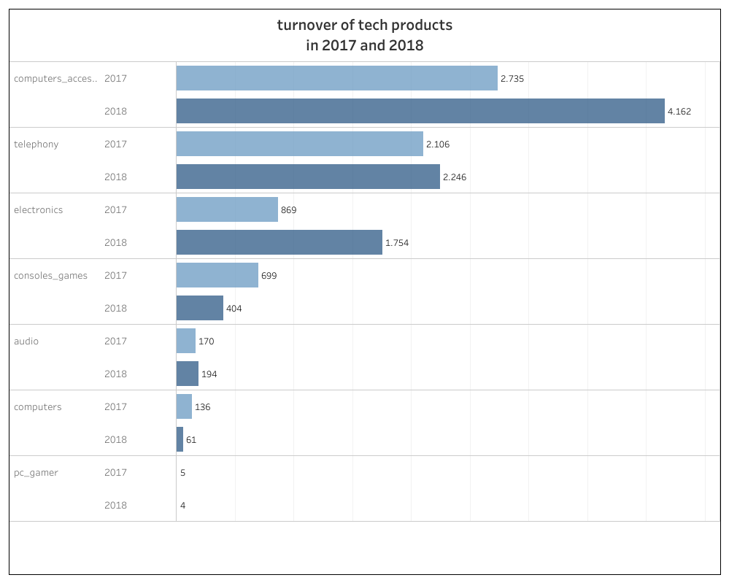

Slide 12
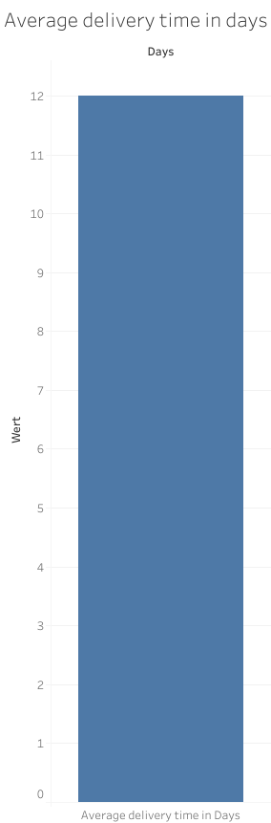

Slide 15

THANK YOU

